Slide 1



Access to Higher Education:
Do schools “grant” success?
Nathaniel Jones
Welcome!
This presentation will begin at 1 p.m.
Please mute your microphone.
While you wait connect with me on LinkedIn.
Research Advisor:
Professor Susan Mathews Hardy
Notes:
THINGS TO FINISH:
-SCRIPT:
-(5)Flow from slide to slide
-(1)PELL vs DROP rework to be more concise and less convoluted
-(3)PELL vs GRAD work
-(2)DEP vs IND work
-(4)Summation slides of take-aways and actionable items
-(6)Ending remark
-PowerPoint:
-(4)Make sure statistics are accurate to the findings within the data
-(2)Finish the findings and takeaway lines on each graphical slide
-(3)Put median numbers on the PELL vs GRAD slides under the line
-(5)Animate the changes done to PELL vs GRAD
-(1)Finish filling in the CORRECT summary(KEY INFO) and ACTIONS on the ‘Information is Key’ slide
-(6)Fix any animation errors.
PLACE FINISH SCRIPT SNIPPETS IN THE NOTEBOX AS THEY ARE COMPLETED.

Slide 2




THE BROOKINGS INSTITUTE
The U.S. Bureau of Labor Statistics claims the median weekly earnings in 2019 for all U.S. workers was $969. Of those, workers who held bachelor’s degrees earned a median weekly pay of $1,248.
In 2016, the Brookings Institute found that, in comparison to other loan borrowers, those that received a Pell Grant attended universities that had lower graduation rates and higher loan default rates.
U.S. BUREAU OF LABOR STATISTICS

Slide 3

Notes:
SCRIPT [MOTIVATION]
To receive the maximum pell grant of 6000 their family needs to make less than or equal to ***.
This may sound like a lot of money, but it is not enough. I know this because it was my situation.
This is important to leave a legacy of research to help pell recipients benefit from knowledge I have gained and my research.
I researched what things institutions can do to help Pell recipients succeed after graduation in paying off their loans in addition to the Pell grant.

Slide 4




What is a Pell Grant
Given to low-income students
Dependent
Not repaid
Independent
How do students apply
FAFSA !
Less than $50,000
Less than $20,000
$6,345

Slide 5

IPEDS: Integrated Post-secondary Education Data System
% Pell recipients
% Federal loan borrowers
% loan borrowers defaulting within two-years
% of students graduating
% of students that dropout
Median student debt accumulated by a typical student
Median student debt accumulated by a typical dependent student
Median student debt accumulated by a typical independent student

Slide 6

The Questions to Ask
“How do Majority and Minority Pell institutions compare for graduation rates?”
“Do majority Pell institutions have a higher dropout rate?”
“Do students at majority Pell institutions have a higher 2-year default rate?”
“Do students who are independent from their parents take on the same amount of debt as students who are dependent?”
“Is there a relationship between loan default rate and graduation rate?”
Notes:
USER FRIENDLY Hypothesis
Can remove ks logo
The question we are on turn colors.

Slide 7
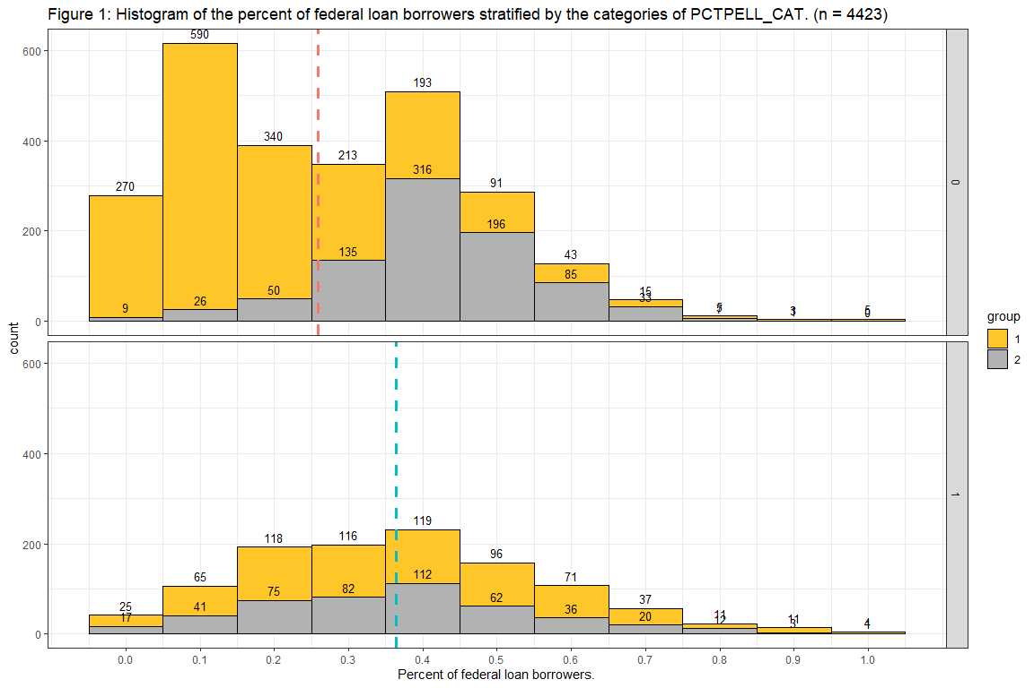
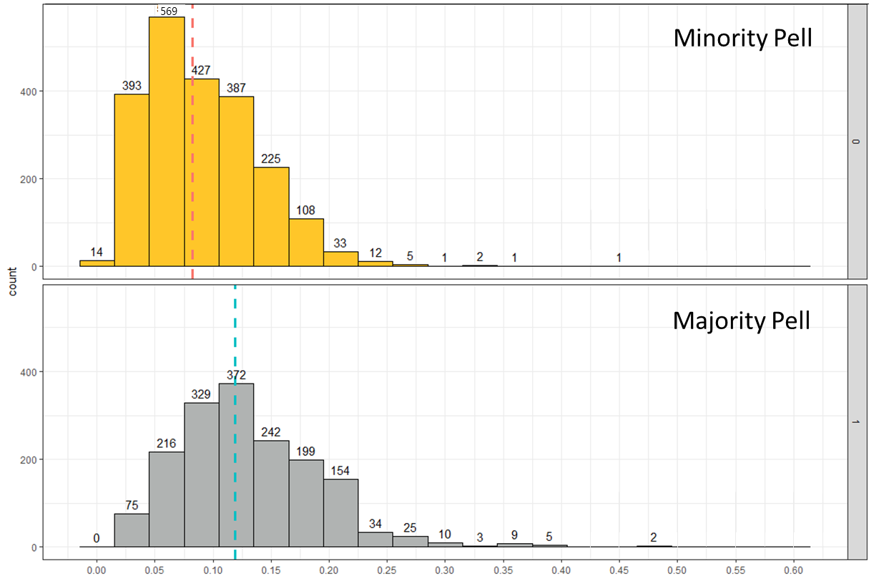
Pell Grant vs 2-year Default Rate
FINDING
The difference in the median percent of students that is in default at Majority Pell Institutions is 3.5% to 4.2% higher than Minority Pell Institutions.
TAKE-AWAY
Students receiving a Pell Grant attended universities with a higher 2-year loan default rate.
8%
12%
Percent of federal loan borrowers who entered default within 2 years
Notes:
We found that brookings was correct that majority Pell institutions have a higher default rate

Slide 8
The Questions to Ask
“How do Majority and Minority Pell institutions compare for graduation rates?”
“Do majority Pell institutions have a higher dropout rate?”
“Do students at majority Pell institutions have a higher 2-year default rate?”
“Do students who are independent from their parents take on the same amount of debt as students who are dependent?”
“Is there a relationship between loan default rate and graduation rate?”
Notes:
USER FRIENDLY Hypothesis
Can remove ks logo
The question we are on turn colors.

Slide 9
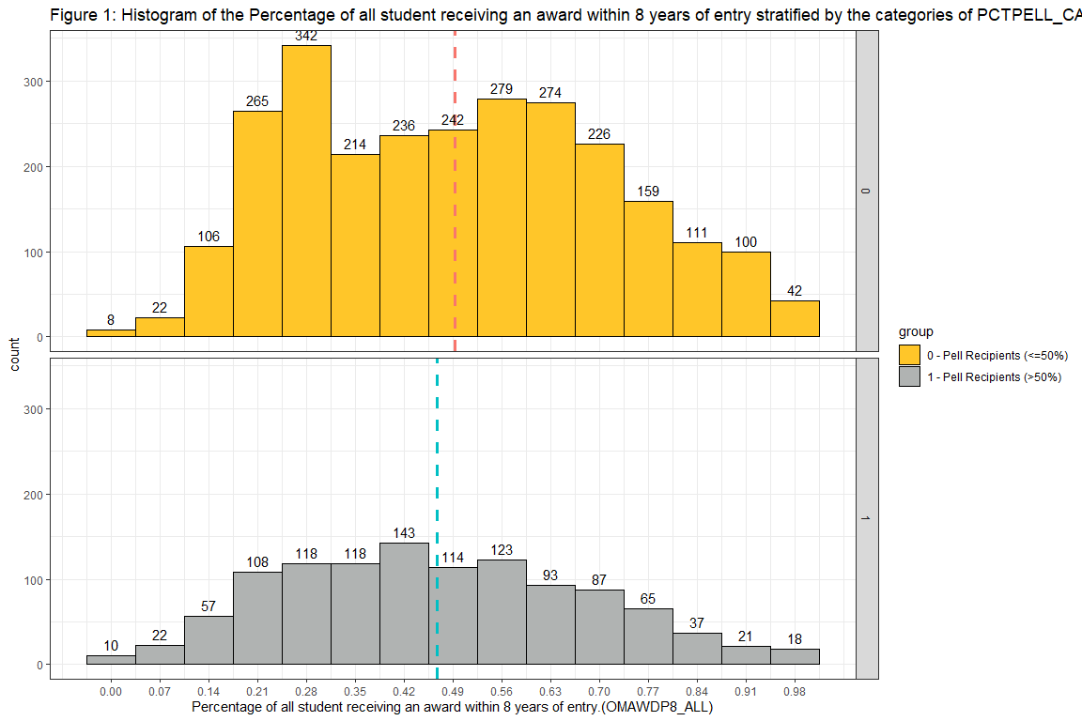
Pell Grant vs Graduation
Minority Pell
FINDING
The difference in the median percent of students that graduated at a Majority Pell Institutions is 1% to 4% lower than Minority Pell Institutions.
TAKE-AWAY
Students receiving a Pell Grant attended universities with lower graduation rates.
49%
Majority Pell
45%
Percent of Students that graduated within 8 years
Notes:
We found that brookings was correct that majority Pell institutions have a higher default rate

Slide 10
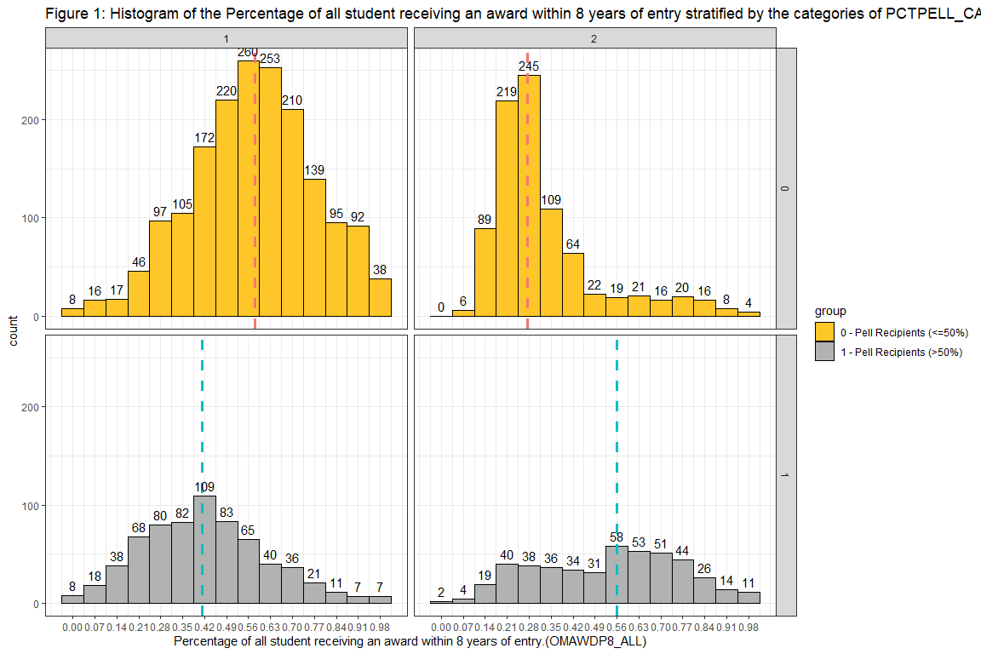
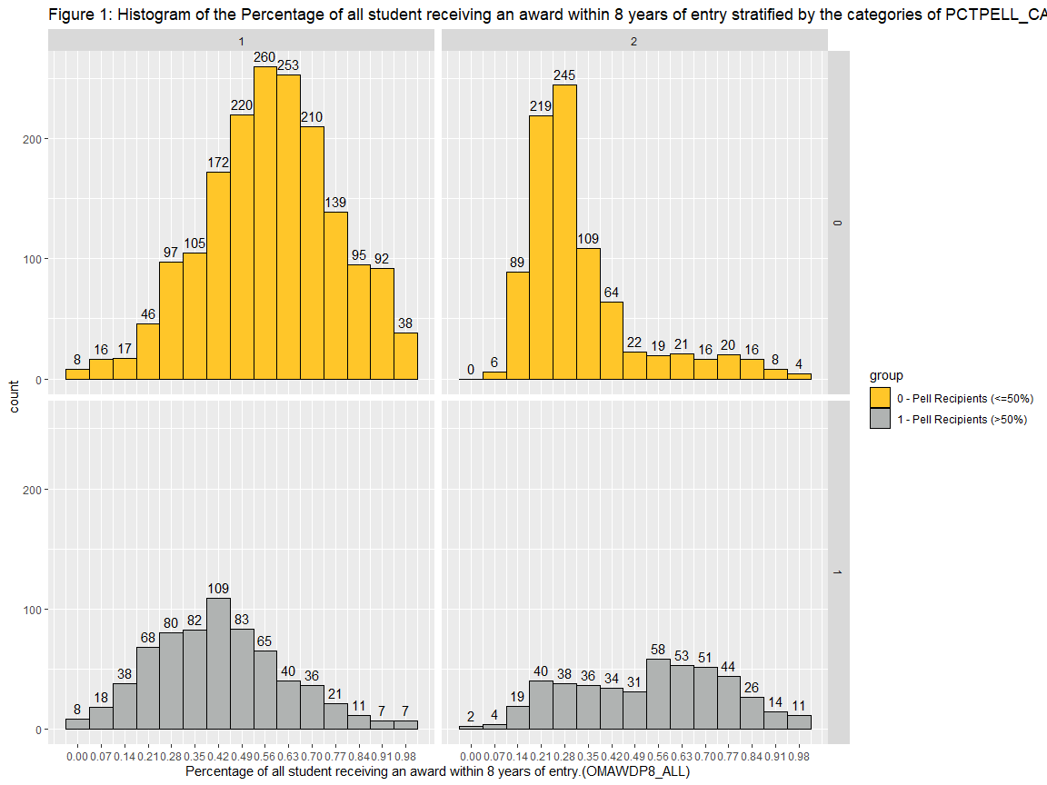
2-year
4-year
Pell Grant vs Graduation
Minority Pell
FINDING
4-year Graduation Rate
4-year Majority Pell schools have a 17% lower rate than 4-year Minority Pell schools.
2-year Graduation Rate
2-year Majority Pell schools have a 28% higher rate than 2-year Minority Pell schools.
Majority Pell—2-year Combination
Private 2-year Majority Pell schools have a graduation rate of 62%.
28%
58%
Majority Pell
Public 26%
Private 62%
56%
41%
Percent of Students that graduated within 8 years
Notes:
We found that brookings was correct that majority Pell institutions have a higher default rate
TAKE-AWAY
4-year minority Pell schools had a much higher graduation rate than 4-year majority Pell schools
2-year minority Pell schools acted similar to what we found during drop

Slide 11



Information is Key to Solutions
Key Findings
Key Findings
Majority Pell institutions have higher default rates than Minority Pell institutions.
Majority Pell institutions have LOWER graduation rates than Minority Pell institutions.
Notes:
SUMMARY BULLETS come from red lines.
USER FRIENDLY Hypothesis
Can remove ks logo
The question we are on turn colors.

Slide 12
The Questions to Ask
“How do Majority and Minority Pell institutions compare for graduation rates?”
“Do majority Pell institutions have a higher dropout rate?”
“Do students at majority Pell institutions have a higher 2-year default rate?”
“Do students who are independent from their parents take on the same amount of debt as students who are dependent?”
“Is there a relationship between loan default rate and graduation rate?”
Notes:
USER FRIENDLY Hypothesis
Can remove ks logo
The question we are on turn colors.

Slide 13
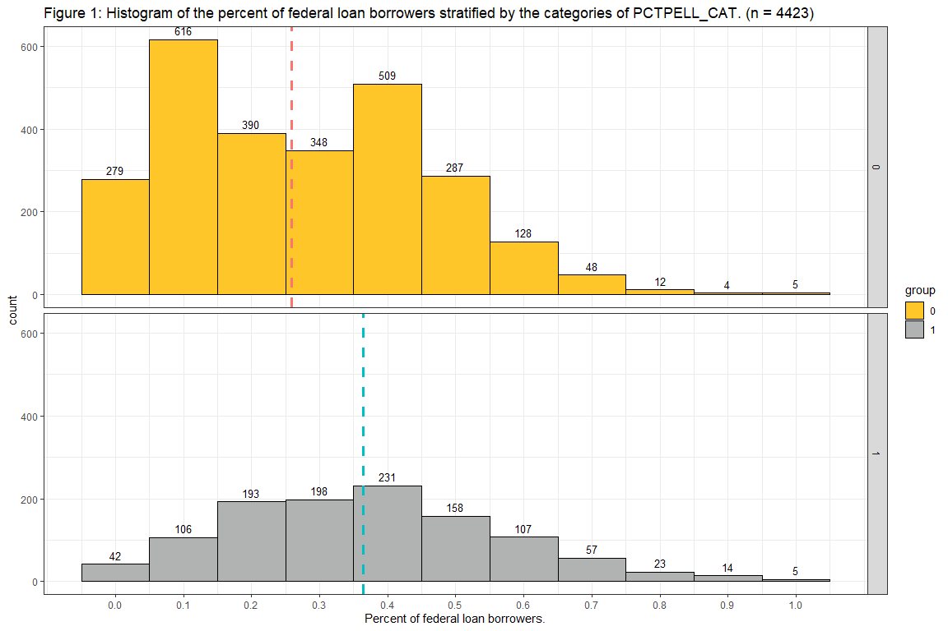
Pell Grant vs Dropout rate
FINDING
We are 95% confident that the median dropout rate for Majority Pell institutions is from 8 to 11% higher than Minority Pell institutions.
TAKE-AWAY
Majority Pell institutions have a higher dropout rate than Minority Pell institutions.
Minority Pell
26%
26%
Majority Pell
36%
Dropout rate
Notes:
This is confusing. facet apart the types
(4-facet)
GRAD VERSION
MAKE SURE SCRIPT GOES
Majority Pell
When we see two modes, we look for what categorical variable that would explain the two modes. (2-year/4-year)
If i was speaking to a 2-year institution I would be recomen the action item about educating their students about the pell grant.
Since I am talking to Kennesaw state, which is a 4-year inst, I would recommend that you are better off to have students not drop out already.
Action
-Less likely to drop out of school at a 4-year institution vs 2-year inst
-Maybe because 2-year inst have a low pell rate for the reason that their students do not know they are eligible for the Pell grant.

Slide 14
The Questions to Ask
“How do Majority and Minority Pell institutions compare for graduation rates?”
“Do majority Pell institutions have a higher dropout rate?”
“Do students at majority Pell institutions have a higher 2-year default rate?”
“Do students who are independent from their parents take on the same amount of debt as students who are dependent?”
“Is there a relationship between loan default rate and graduation rate?”
Notes:
USER FRIENDLY Hypothesis
Can remove ks logo
The question we are on turn colors.

Slide 15
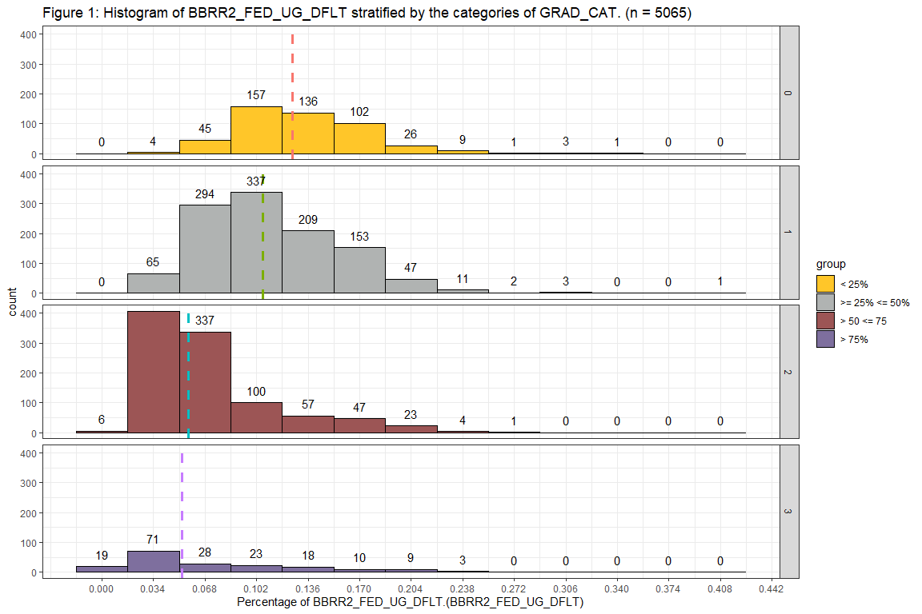
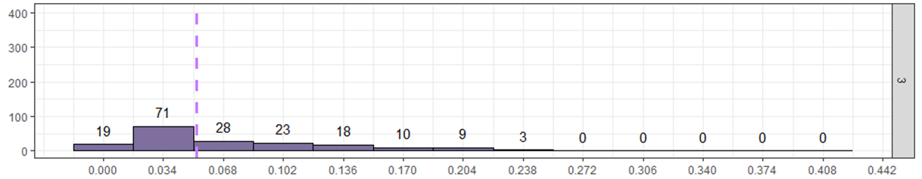
Graduation Rate vs Default Rate
< 25% students graduate within 8 years
12.56%
25% <= and <= 50% students graduate within 8 years
count
400
10.07%
50% < and <= 75% students graduate within 8 years
5.67%
> 75% students graduate within 8 years
5.28%
Percent of federal loan borrowers who entered default within 2 years
Notes:
USER FRIENDLY Hypothesis
Can remove ks logo
The question we are on turn colors.

Slide 16
Information is Key to Solutions
Key Findings
Key Findings
Majority Pell schools have higher default rates than Minority Pell institutions.
Majority Pell institutions have a higher dropout rate than Minority Pell
institutions.
Key Findings
Majority Pell institutions have LOWER graduation rates than Minority Pell institutions.
Notes:
SUMMARY BULLETS come from red lines.
USER FRIENDLY Hypothesis
Can remove ks logo
The question we are on turn colors.

Slide 17
The Questions to Ask
“How do Majority and Minority Pell institutions compare for graduation rates?”
“Do majority Pell institutions have a higher dropout rate?”
“Do students at majority Pell institutions have a higher 2-year default rate?”
“Do students who are independent from their parents take on the same amount of debt as students who are dependent?”
“Is there a relationship between loan default rate and graduation rate?”
Notes:
USER FRIENDLY Hypothesis
Can remove ks logo
The question we are on turn colors.

Slide 18
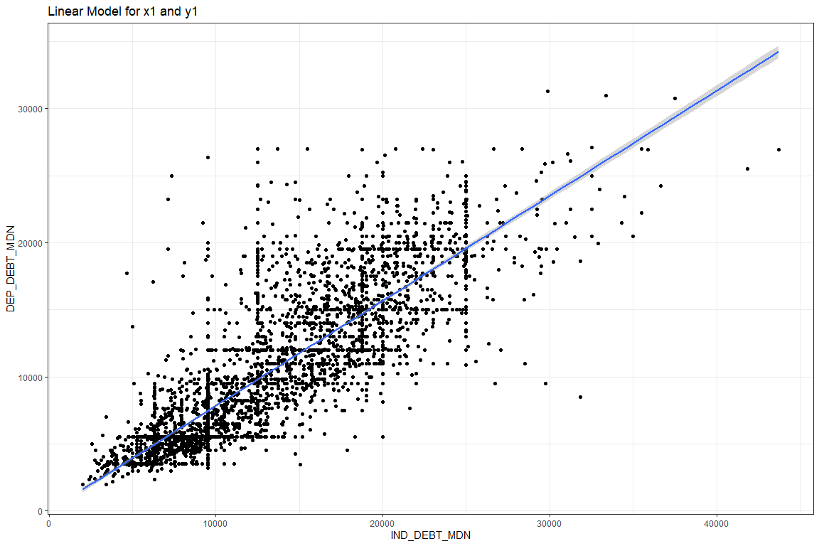
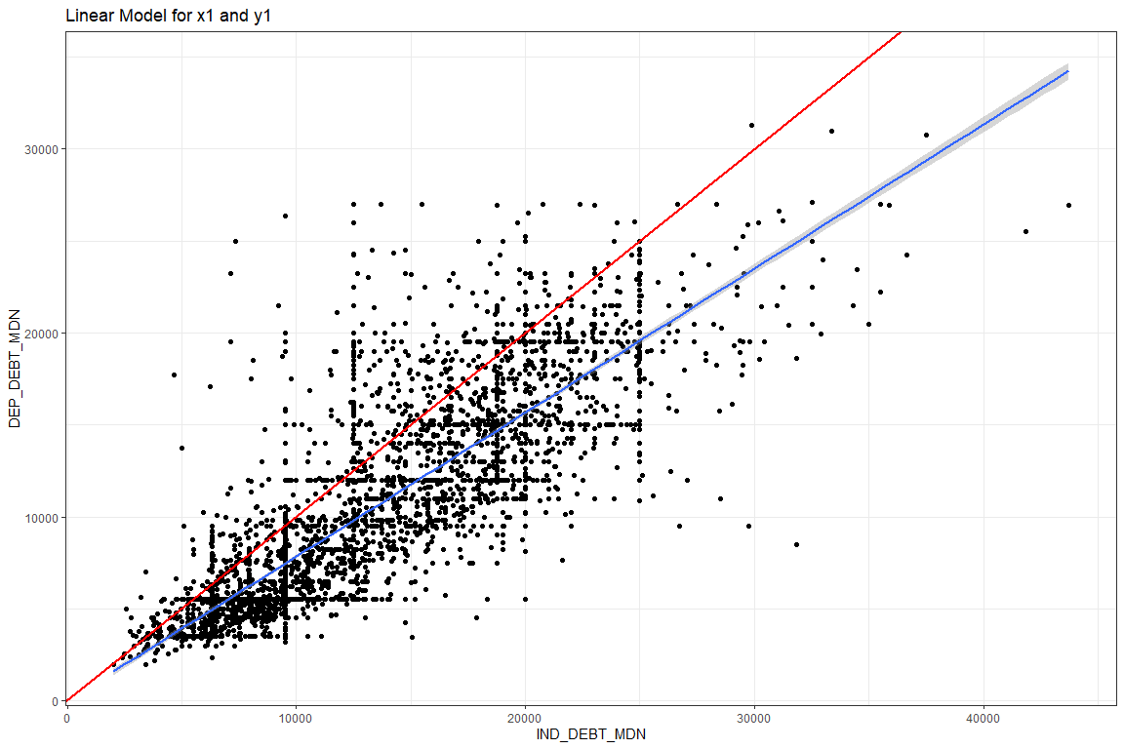
Independent vs Dependent
Independent = Dependent
Independent > Dependent
Independent > Dependent
Typical debt taken on by Dependent Students
Typical debt taken on by Independent Students
Notes:
SLIDE 1-7: measure success
SLIDE 8-n: goes with the drop the mic ending about dependent debt and plus loan debt.
INDY take out more because they have the eligibility.
Ind has more debt then dep
At this point I want to tell my story of
Dep students take less than independent.
Another part of this story that I will doing research on for the rest of the year as I present on other conference.
I will be looking at PLUS loan debt in combination to dependent and indepdent debt.
Even from this graphic, one can see that those who are dependent debt take out more than the independent counterparts.
One of the things I would counsel everyone here is to educate their friends and those in authority their students, the
Implication of being dependent. Their parents can take out PLUS debt which will limit the amount of money the student
Can take out.
My parents took thousands in PLUS loan debt that prevented me from
Poor family, qualified for full pell
These families can take PLUS loans that are supposed to be used for the student's academic progress.
But there is no legal check on the system to ensure these parents are utilizing this loan.
This caused me to not be able to afford medical cost, housing issues, and academic stress.
I was never counselled on the difference between dependent and independent.
Thus, this topic is very important to me, and I will be continuing to research
Thank you for coming. So that you can make a difference in peoples lives.
Thank you *specific ppl*
**I would like to recognize you
aethnography
Communicated with Student success services
Slept in ENO at K-Hall to show homelessness.
Continuelly talked about my situation with this depart.
Food that does not need to be cooked
X is bigger than y meaning the debt x is bigger than yx

Slide 19

Parents can take out large-sum loans.
Nothing forces parents to disburse money to the student.
Students need information and counseling on dependency status.
Parent Plus Loans
Financial aid counselors can help prevent fraudulent PLUS loans.

Slide 20


Questions?
Nathaniel Jones
njones71@students.kennesaw.edu
Thank you!

Slide 21
The Questions We Answered
“How do Majority and Minority Pell institutions compare for graduation rates?”
“Do majority Pell institutions have a higher dropout rate?”
“Do students at majority Pell institutions have a higher 2-year default rate?”
Majority Pell have more students that drop out within 8 years.
Majority Pell schools have a lower graduation rate at 4-year schools.
Majority Pell schools have more students that default on their loans within 2 years.
“Do students who are independent from their parents take on the same amount of debt as students who are dependent?”
“Is there a relationship between loan default rate and graduation rate?”
Schools that graduate more than 50% of their students have a lower default rate.
Independent students take on more debt.
Notes:
USER FRIENDLY Hypothesis
Can remove ks logo
The question we are on turn colors.

Slide 24
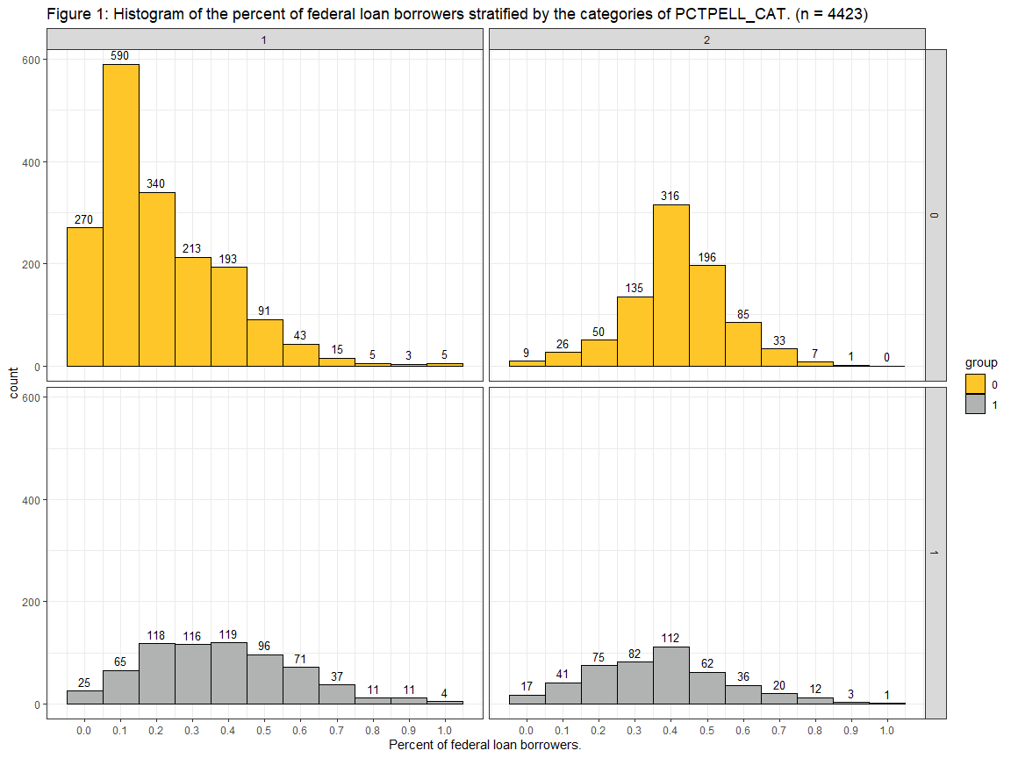
Pell Grant vs Dropout rate
4-year
2-year
Minority Pell
FINDING
Minority Pell 2-year institutions have a 26% higher dropout rate than Minority Pell 4-year institutions.
Majority Pell schools have a median drop out rate of 36%.
16%
26%
26%
26%
42%
Majority Pell
TAKE-AWAY
Minority Pell institutions warrant further study to determine why there is a 26% difference between
4- year and 2-year institutions.
36%
36%
36%
Dropout rate
Notes:
This is confusing. facet apart the types
(4-facet)
GRAD VERSION
MAKE SURE SCRIPT GOES
Majority Pell
When we see two modes, we look for what categorical variable that would explain the two modes. (2-year/4-year)
If i was speaking to a 2-year institution I would be recomen the action item about educating their students about the pell grant.
Since I am talking to Kennesaw state, which is a 4-year inst, I would recommend that you are better off to have students not drop out already.
Action
-Less likely to drop out of school at a 4-year institution vs 2-year inst
-Maybe because 2-year inst have a low pell rate for the reason that their students do not know they are eligible for the Pell grant.

Slide 25
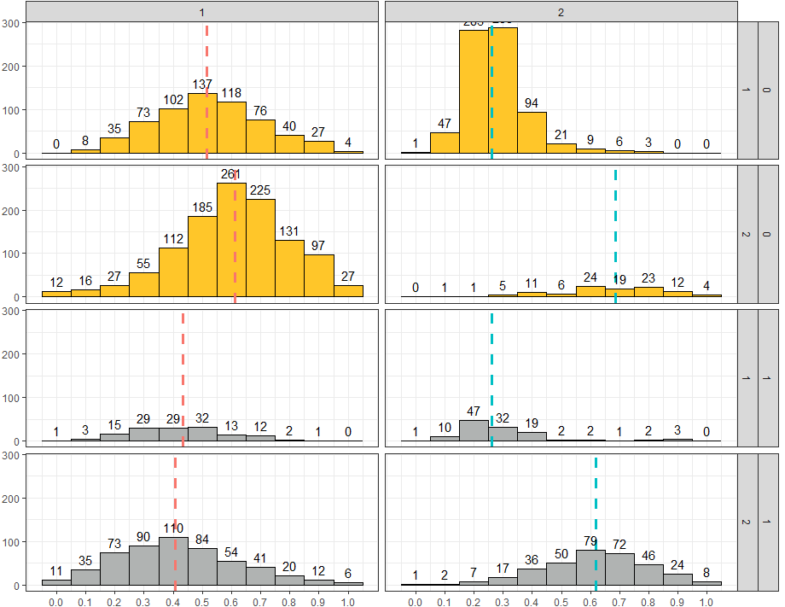
4-year
2-year
Pell Grant vs Graduation
Minority Pell
Public
FINDING
graduation.
TAKE-AWAY
graduation
Private
Majority Pell
Public
Private
Percent of Students that graduated within 8 years
Notes:
We found that brookings was correct that majority Pell institutions have a higher default rate

Slide 28
The Questions We Answered
“How do Majority and Minority Pell institutions compare for graduation rates?”
“How do the 2-year loan default rates compare for Majority and Minority Pell institutions?”
“Do Majority Pell institutions have a higher percentage of federal loan borrowers?”
Majority Pell schools have a lower graduation rate at 4-year schools.
Majority Pell schools have more students that default on their loans within 2 years.
Majority Pell schools take out more loans than minority Pell schools.
“Do students who are independent from their parents take on the same amount of debt as students who are dependent?”
“Do majority Pell institutions have a higher dropout rate?”
“Is there a relationship between loan default rate and graduation rate?”
Majority Pell have more students that drop out within 8 years.
Schools that graduate more than 50% of their students have a lower default rate.
Independent students take on more debt.
Notes:
USER FRIENDLY Hypothesis
Can remove ks logo
The question we are on turn colors.

Slide 33
Information is Key to Solutions
Key Findings
Further Research
4-year Majority Pell institutions have 17% LOWER graduation rates than 4-year Minority Pell institutions.
2-year Majority Pell institutions have a 28% HIGHER graduation rates than 2- year Minority Pell Institutions
Graduation rates of over 50% are associated with LOWER loan default rates of approximately 5%, as compared to loan default rates of above 10% for lower graduation rates.
Minority Pell 2-year institutions have a 26% higher dropout rate than Minority Pell 4-year institutions.
Notes:
SUMMARY BULLETS come from red lines.
USER FRIENDLY Hypothesis
Can remove ks logo
The question we are on turn colors.

Slide 42

The Questions to Ask
“Do majority Pell institutions have a higher default rate than minority Pell institutions?”
“Does having a high percentage of Pell Grant recipients mean that the institution have a lower percent of federal loan borrowers?”
“Do majority Pell institutions have a higher dropout rate?”
“Is the default rate lower at institutions who graduate a higher percentage of their students?”
“Do independent and dependent students taking on the same amount of debt?”
Notes:
USER FRIENDLY Hypothesis
Can remove ks logo
The question we are on turn colors.

Slide 43
The Questions to Ask
“Do majority Pell institutions have a higher default rate than minority Pell institutions?”
“Does having a high percentage of Pell Grant recipients mean that the institution have a lower percent of federal loan borrowers?”
“Do majority Pell institutions have a higher dropout rate?”
“Is the default rate lower at institutions who graduate a higher percentage of their students?”
“Do independent and dependent students taking on the same amount of debt?”
Notes:
USER FRIENDLY Hypothesis
Can remove ks logo
The question we are on turn colors.

Slide 44
The Questions to Ask
“Do majority Pell institutions have a higher default rate than minority Pell institutions?”
“Does having a high percentage of Pell Grant recipients mean that the institution have a lower percent of federal loan borrowers?”
“Do majority Pell institutions have a higher dropout rate?”
“Is the default rate lower at institutions who graduate a higher percentage of their students?”
“Do independent and dependent students taking on the same amount of debt?”
Notes:
USER FRIENDLY Hypothesis
Can remove ks logo
The question we are on turn colors.

Slide 45
The Questions to Ask
“Do majority Pell institutions have a higher default rate than minority Pell institutions?”
“Does having a high percentage of Pell Grant recipients mean that the institution have a lower percent of federal loan borrowers?”
“Do majority Pell institutions have a higher dropout rate?”
“Is the default rate lower at institutions who graduate a higher percentage of their students?”
“Do independent and dependent students taking on the same amount of debt?”
Notes:
USER FRIENDLY Hypothesis
Can remove ks logo
The question we are on turn colors.

Slide 46
The Questions to Ask
“Do majority Pell institutions have a higher default rate than minority Pell institutions?”
“Does having a high percentage of Pell Grant recipients mean that the institution have a lower percent of federal loan borrowers?”
“Do majority Pell institutions have a higher dropout rate?”
“Is the default rate lower at institutions who graduate a higher percentage of their students?”
“Do independent and dependent students taking on the same amount of debt?”
Notes:
USER FRIENDLY Hypothesis
Can remove ks logo
The question we are on turn colors.

Slide 47

The Questions We Answered
“Do majority Pell institutions have a higher default rate than minority Pell institutions?”
“Does having a high percentage of Pell Grant recipients mean that the institution have a lower percent of federal loan borrowers?”
“Do majority Pell institutions have a higher dropout rate?”
Majority Pell schools have more students default on their loans within 2 years.
Majority Pell have more students that drop out within 8 years.
Majority Pell schools take out more loans than minority Pell schools.
“Is the default rate lower at institutions who graduate a higher percentage of their students?”
“Do independent and dependent students taking on the same amount of debt?”
Schools that graduate more than 50% of their students have a lower default rate.
Independent students take on more debt.
Notes:
USER FRIENDLY Hypothesis
Can remove ks logo
The question we are on turn colors.

